Slide 1
Birth Spacing Counselling During Postnatal Care
Notes:
Hello and welcome to this training on family planning counselling. Thank you so much for taking the time to attend.

Slide 2
Agenda
Project overview
Counselling approach
Conversation guide
Method cards
Skills test
Concluding remarks

Slide 3
Welcome!

Slide 4
Guidelines
Respect one another
Keep an open mind
No answers are wrong
Phones on silent
Notes:
Here are a few guidelines for today. Most importantly, respect one another. Listen and take seriously what your fellow participants say, even if you disagree. It’s also important to keep an open mind: there is a lot to know about family planning. Make sure to please speak up if you have questions: raise your hand at any time if you want to ask a question. We’re here to learn!
In order to make these possible, please do not use your phone during sessions.

Slide 5
Project Overview

Slide 6
Change to Care
We expect you to provide individual family planning counselling to every women who attends a postnatal care session
This is in line with the national policy of the Ghana Health Service. The purpose of this training and programme is to test the increases to uptake and informed choice from consistent 1:1 counselling at PNC

Slide 7
Change to Care
We have provided materials to make it quicker and easier to do this:
Conversation guide for talking with clients about family planning
Method cards to help you explain the options and explore them with the client
Method Information Booklet for refreshing your knowledge on family planning
Referral cards to encourage clients interested in taking up a family planning method to visit the family planning unit.

Slide 8
Accountability
External follow-up surveys will be conducted in one month to check whether care is occurring according to the training
Phone follow-up surveys with a random sampling of clients will be conducted weekly
Brief knowledge checks through a WhatsApp-based tool in the weeks following the training

Slide 9
Reach out to your programme champion!
Each hospital has one programme champion - a team member who has been asked to do additional work to support the program
They are there to support you if you have questions or concerns about the materials and the approach that you are trained in today
Programme champions: please stand up

Slide 10
2. Counselling Approach

Slide 11
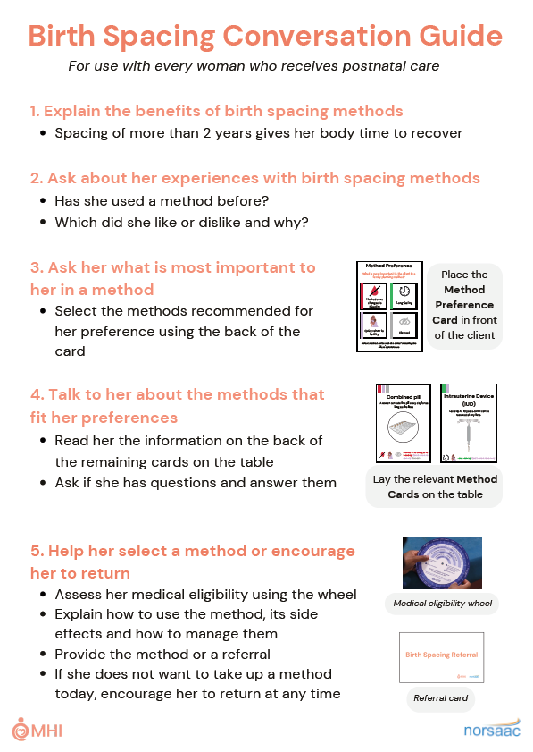
What is the conversation guide?
Will help you ask the right questions and provide crucial information
Should be used with every client
Place on the table at the beginning of each session
Keep a conversation guide at the place where you provide PNC; each provider should also have their conversation guide
Has everyone received a conversation guide document?

Slide 12
Your role
Listen to your client’s concerns and preferences
She might be worried about how methods will affect her health
Provide women with accurate information
Many women have misconceptions about their risk of pregnancy and birth spacing options
Empower women to make and carry out their own decisions
It’s her decision – not yours or her husband’s
Many women want to use a method, but encounter access barriers

Slide 13
What does client-centred care mean?

Slide 14
Key Concept: Care should be client-focused
Session should be a conversation, not a lecture
Client shares preferences throughout conversation
Client shares concerns about birth spacing methods

Slide 15
Creating a comfortable environment
Set clear expectations
I want to hear from you; I will listen to your concerns and preferences.
You can ask questions at any time as everything you say is private
Throughout the conversation
You should remain kind, curious and patient.
If the client seems embarrassed or nervous, remind her that what the client says is confidential.

Slide 16
Step 1: Explain the benefits of birth spacing
Benefits to baby:
More likely to be healthy and strong
Benefits to mother:
More likely to be healthy
More time for baby and rest of family
Benefits to family:
More resources for food, clothing, housing, and education

Slide 17
Step 2: Ask about her experiences with birth spacing methods
Has she used a method before?
Which did she like or dislike and why?

Slide 18
Most women have used a method before
STEP 2
Our surveying found that 2 in 3 women attending a health centre had used a birth spacing method before
It is important to ask about the client’s previous experiences, because they will affect her decision
Question
What experiences might a woman have had with birth spacing methods?
Notes:
Wait for the room to provide answers to the question. Prompt if they do not talk about previous negative experiences with side effects, e.g. irregular bleeding, cramping, headaches or nausea.

Slide 19
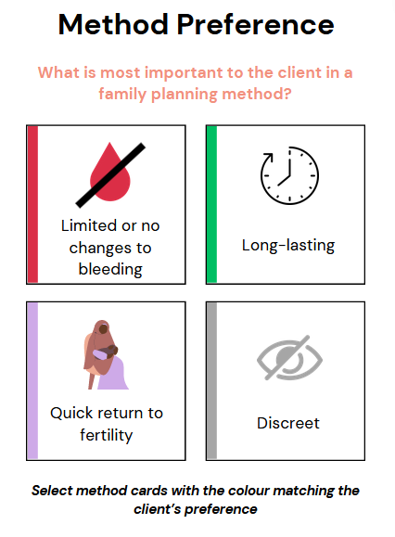
Step 3: Ask about her preferences for a method
Lay down the method preference card
Ask the client what is most important to her in a family planning method
Counsel based on her response
Defuse misconceptions when possible
Discuss methods that meet her preferences
Has everyone received method cards?

Slide 20
Key Concept: Method Preference
STEP 3
Birth spacing methods are not one-size-fits all: there is no one method that is best for every woman
Rates of method discontinuation are high when women are given methods that they don’t like

Slide 21
Your role is to help her learn
STEP 3
You should:
Show you have heard her concern by summarising what she has said
Explain that birth spacing methods are safe and effective
Specifically address her concern
For example: “after you stop using injectables, it can take a little while to get pregnant, but you will be able to after a few months”
If you are unsure what to say, use the Method Information Booklet for guidance

Slide 22
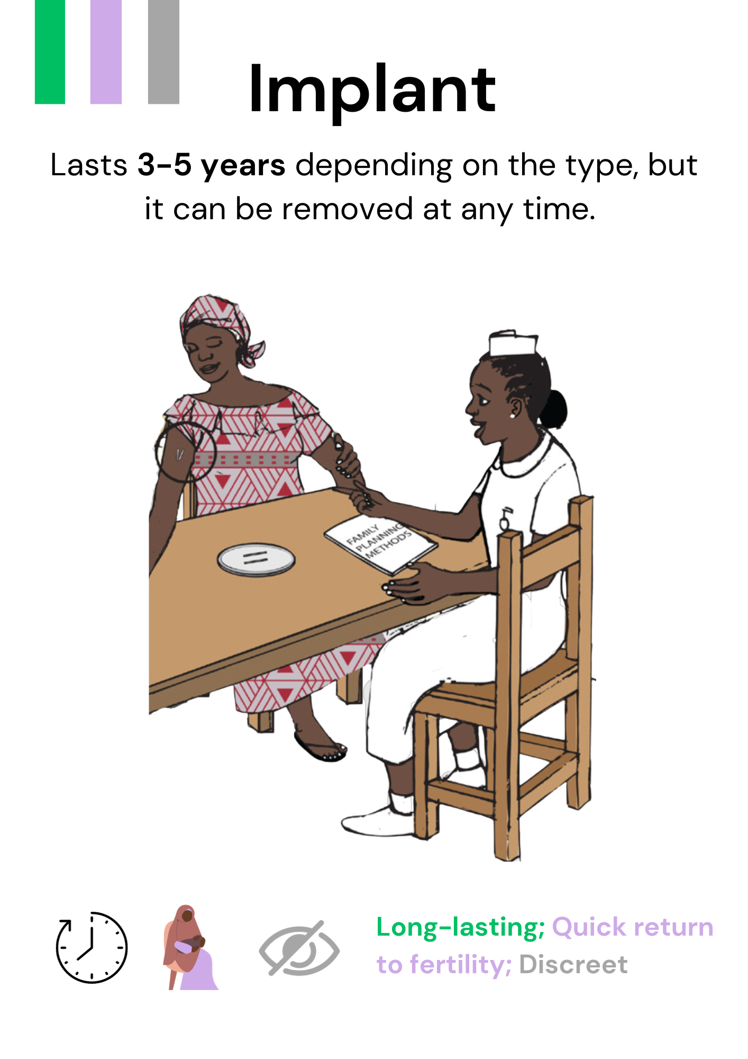
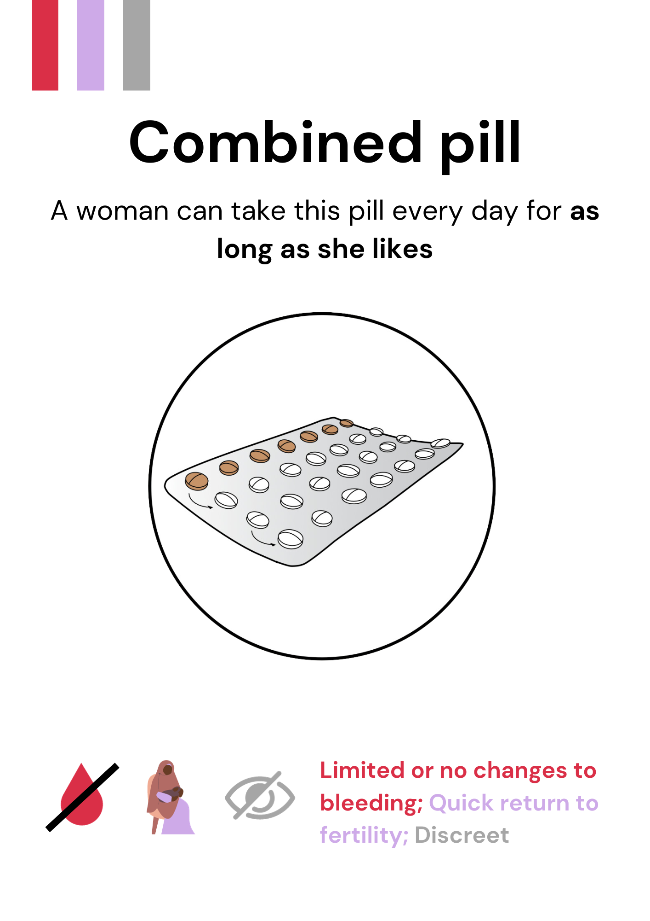
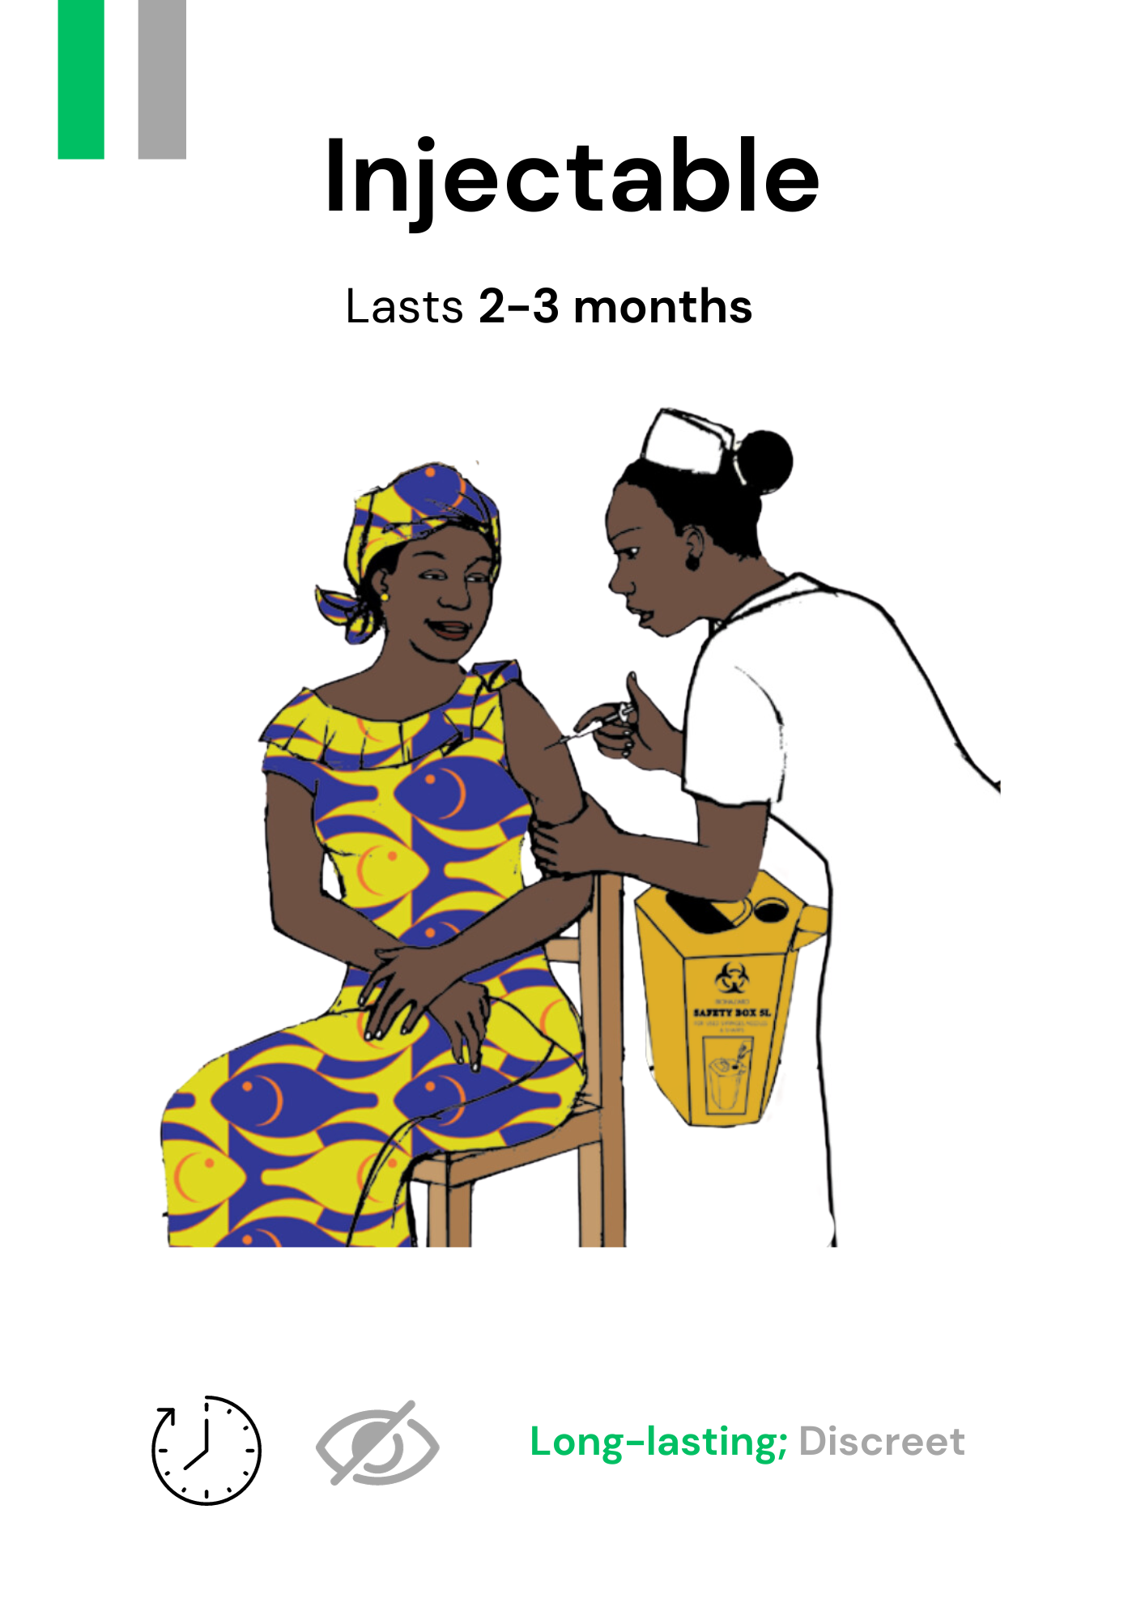
Step 4: Use the method cards to discuss possible methods
Method cards include the Method Preference Card, the Postpartum Method Safety card, and one card for each method
More detailed information is on the back of the card
Keep a set of method cards at the place where you provide PNC; each provider should also have their own set

Slide 23
Step 4: Use the method cards to discuss possible methods
Lay down method cards that meet her preferences – use the colour coding
Ask the client if there are methods she wants to learn more about
Discuss the options based on the information on the back of the card

Slide 24
Step 4: Use the method cards to discuss possible methods
Take away methods that don’t meet her preferences and explain why
Ask if she has questions and answer them
If she asks any questions that you don’t know the answer to, you can look in the Method Information Booklet

Slide 25
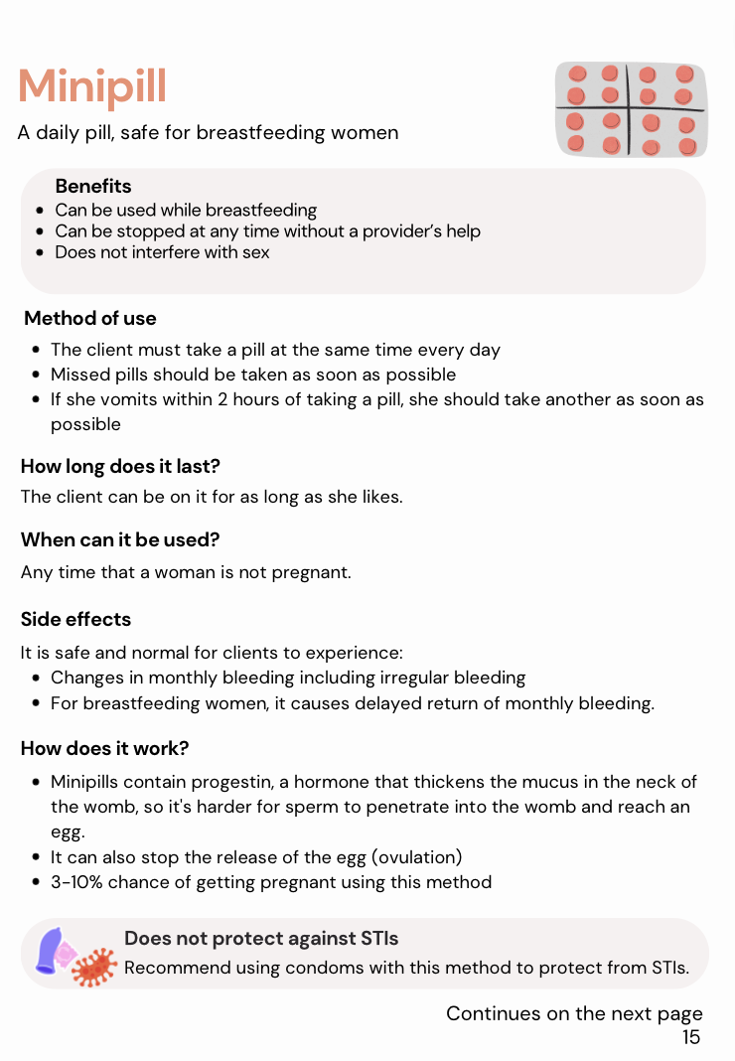
Method information booklet
STEP 4
You do not need to remember all the information about all the different birth spacing methods
The Method Information Booklet has all the information you should need about each method, including:
Benefits
Method of use
Side effect management
Keep a method information booklet at the place where you provide PNC; each provider should also have their conversation guide
Has everyone received a method information booklet?

Slide 26
Step 5: Provide the method and relevant information
Ask: does she want to take up a method?
Check her medical eligibility
Explain method use and side effect management
Provide the method or a referral
If she does not want a method, encourage her to raise any questions she may have at future sessions

Slide 27
How to ask a client about her choice
STEP 5
ASK Are you interested in starting a birth spacing method today?
If no →
Ask if she has any questions or concerns, do not pressure her to take up a method
Make sure she knows she can come back any time if she changes her mind
If yes →
Check you have told her all the information on the card about her chosen method
Make sure the client understands the possible side effects, women are less likely to discontinue a method if they know the side effects in advance
Remember: the goal is to provide client-centred care

Slide 28
Key Concept: Birth Spacing Decision-Making
STEP 5
Women have a right to make their own decisions about birth spacing: it is her choice, not yours or her husband’s
Women do not need their husband’s permission to access birth spacing methods
It is up to women whether they want to inform their husband about their birth spacing choices
Both married and unmarried women may need birth spacing methods.

Slide 29
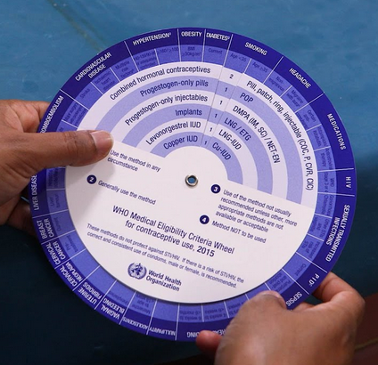
Check medical eligibility
STEP 5
You can easily check eligibility using the medical eligibility wheel
Ask if she has any medical conditions or is taking any medication
Check her duration postpartum: method selection is more limited immediately post-birth
Use the wheel to determine whether she can safely use the chosen method

Slide 30
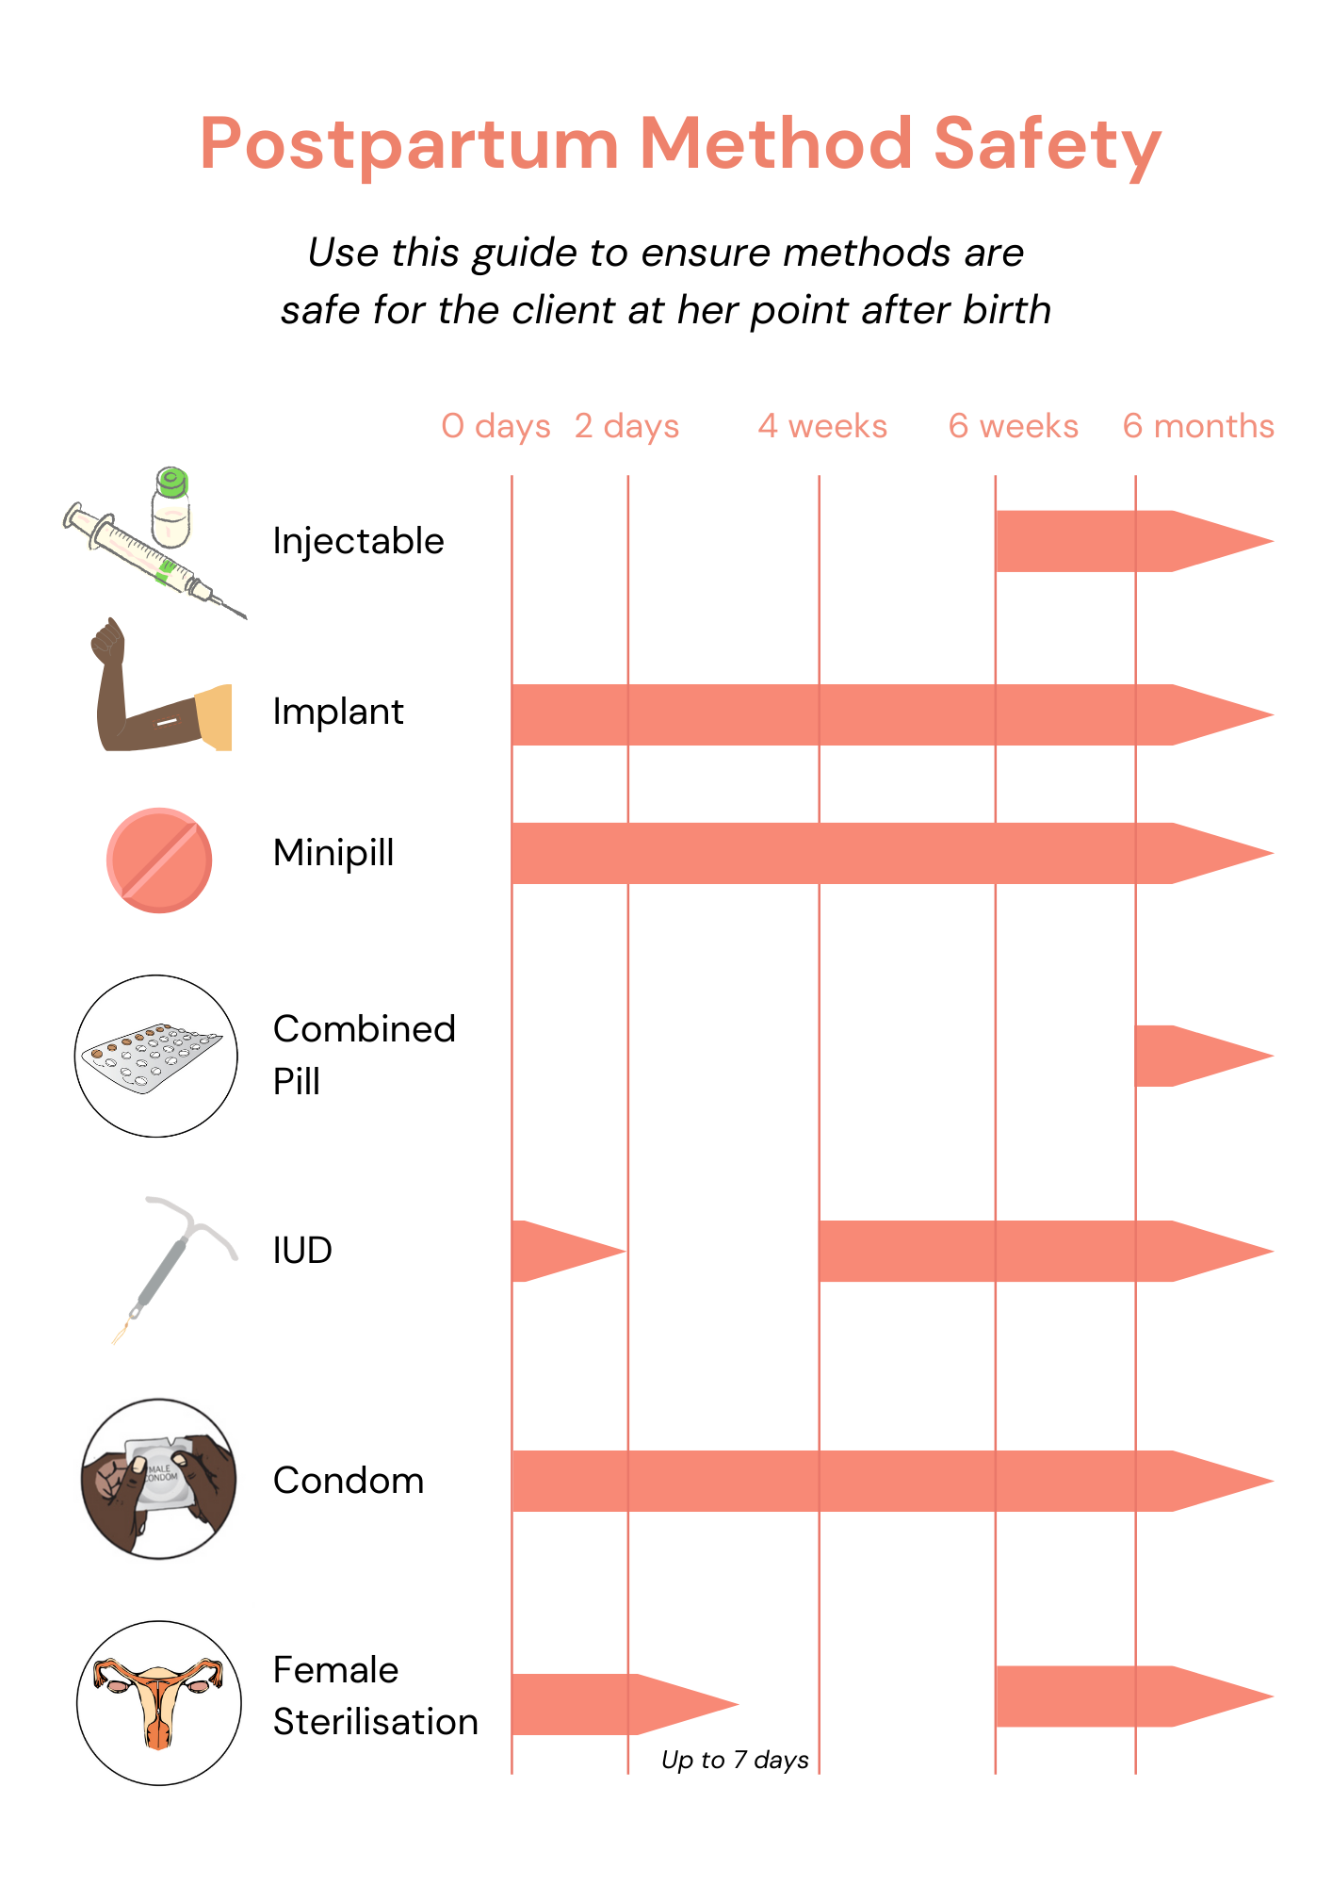
Check which methods can be safely used
STEP 5
As part of the Method Cards, there is a Postpartum Method Safety chart. You can use this to check which methods are safe for her to use
The Method Information Booklet also has this chart and explains any essential tests or medical criteria in the section for each method

Slide 31
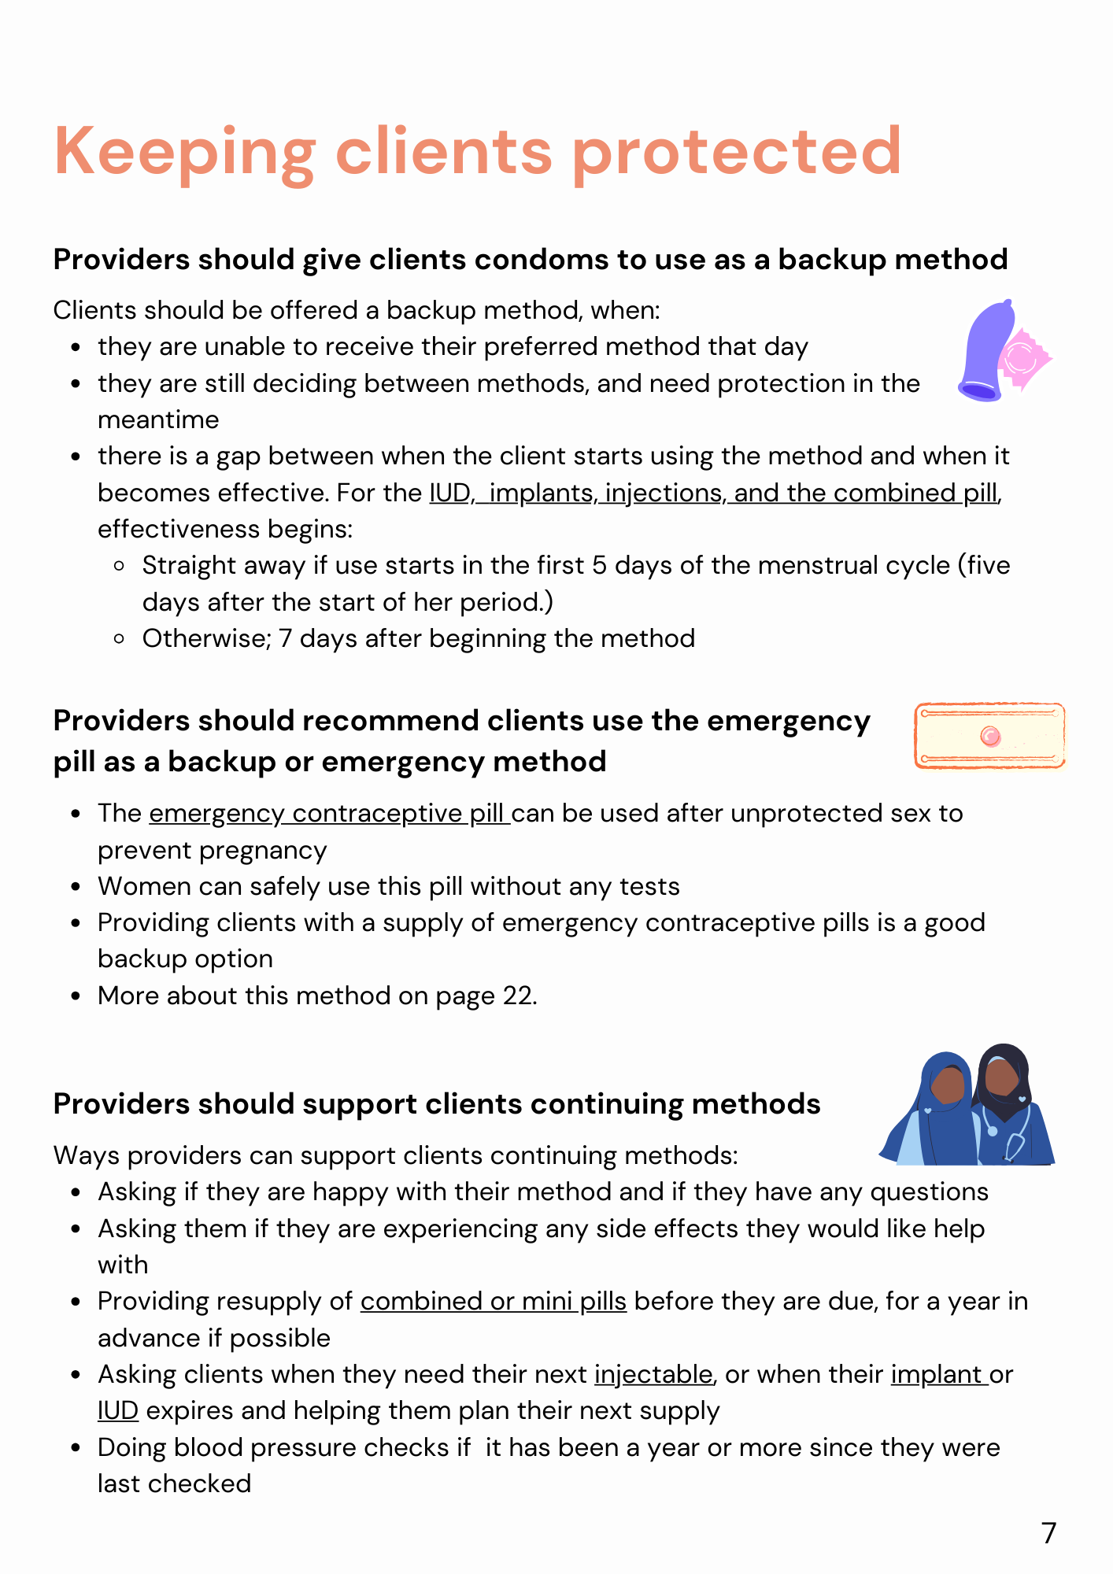
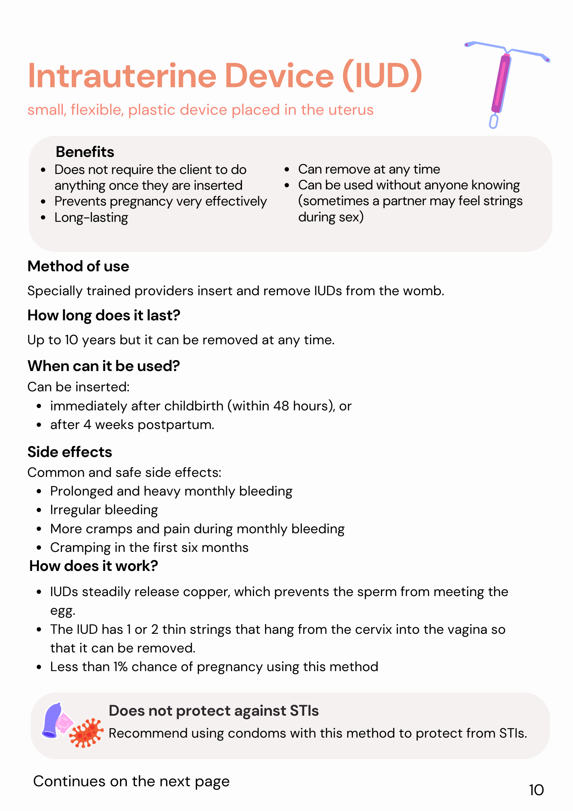
PRACTICE: Looking up information
STEP 4
You have a client who is 2 weeks postpartum
Use the Postpartum Method Safety card or the reference chart on page 3 of the Method Information Booklet to check which methods are safe
Which methods can she use?

Slide 32
PRACTICE: Looking up information
STEP 4
The client who is at her 2-week appointment is eligible for:
Condoms
Implants
Progestin-only/mini pill

Slide 33
Explain correct method use
STEP 5
Pills: timing of pills, what to do if a pill is missed
Condoms: how to use correctly, what to do if the condom breaks
Injectable: timing of injections
LAM: criteria for proper use

Slide 34
Provide the method or a clear referral
STEP 5
For the combined pill, mini pill, or condoms; provide the method
For the other methods; provide a referral for the method
Explain where to get the method and how much it will cost
Ask if they have any questions about getting the method
Offer the client condoms or the mini pill to use in the meantime
Give the client a referral card

Slide 35
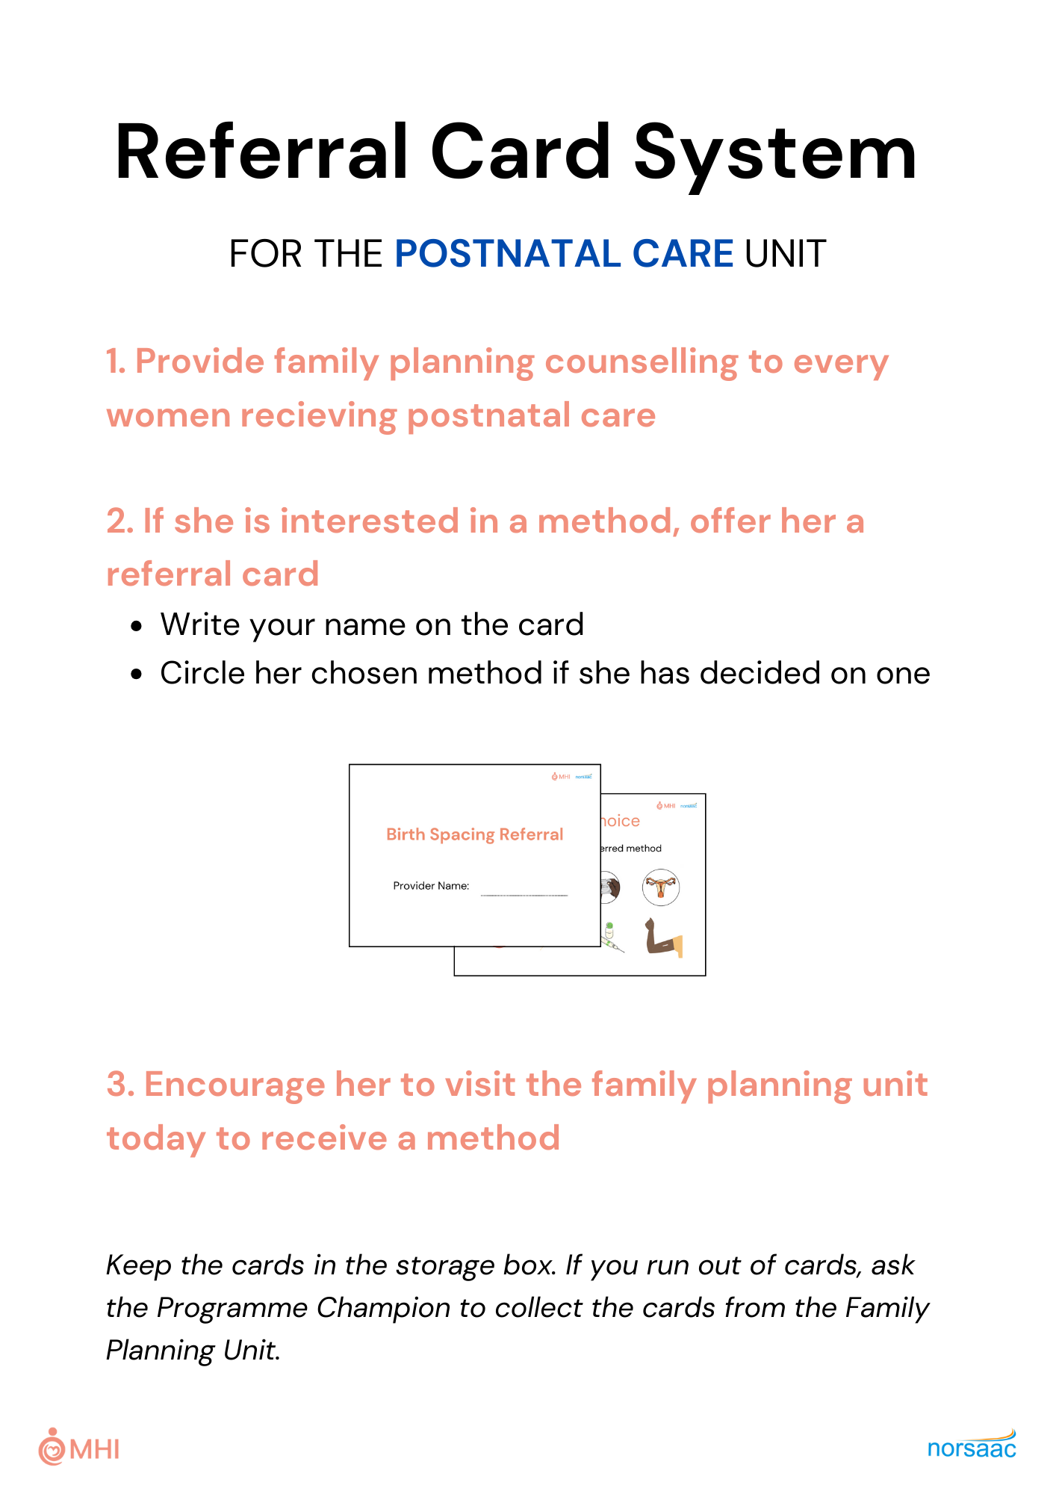
Referral cards
STEP 5
Give referral cards to all clients who want a referral
Circle the chosen method using a marker pen
Once a week, the programme champion will retrieve referral cards from the family planning unit and return them to the PNC area
Each facility will be given a Referral Card System sheet explaining how the referral system should work

Slide 36
Side effect management
STEP 5
Inform the client of possible side effects and how they can be managed
Tell the client that if side effects are a problem, method switching is also an option
Information on how to manage side effects for each method is in the Method Information Booklet

Slide 37
Bleeding side effects
STEP 5
Hormonal methods may cause changes in monthly bleeding including irregular bleeding, spotting, heavier bleeding or no monthly bleeding.
Bleeding changes are safe and regular periods typically return after several months, especially with the implant, IUD, and combined pill.

Slide 38
Managing Bleeding Side Effects
STEP 5
Consult the Method Information Booklet for full details
5-day course of NSAIDs
Ibuprofen – 800 mg (3x per day) for 5 days, OR
Mefenamic Acid – 500 mg (3x per day) for 5 days
Can be repeated monthly, but no more frequently
Combined oral contraceptive can be used for those with bleeding issues who are using the implant, injectable, or IUD
Can be used for up to 3 months
When stopped, the earlier bleeding pattern will likely resume

Slide 39
Come back any time
STEP 5
Before saying goodbye, tell the client that they are free to come back any time with questions or concerns
Inform them that if they are unhappy with any side effects, you can help by providing treatments or alternative methods

Slide 40
3. Practice

Slide 41
Pair Activity: Providing Counselling
Practice providing counselling using the Conversation Guide and Method Cards.
The ‘client’ should give feedback on the following:
ACTIVITY
They actively involved me, asking questions and listening respectfully | Yes/No
They explained to me why they were removing cards | Yes/No
They asked me what cards I was interested in and read out all the information for me | Yes/No
They asked me if I wanted a method and offered me the method or a referral at the end | Yes/No

Slide 42
4. Skills Test

Slide 43
Skills Test
In pairs, you’re going to take turns doing the conversational counselling to each other
The “client” will grade the provider using the “Skills Assessment” in SurveyCTO

Slide 44
Skills Test – Conversational counselling
Make sure to fill out the assessment!
Open SurveyCTO: Collect app
Select “Fill Blank Form”
Select “Skills Assessment - PNC”
Remember to:
Cover all 5 sections
Actively involve the client
Ask the client about their concerns and if they have any questions

Slide 45
5. Concluding Remarks

Slide 46
Recap: Project Activities
We are providing you training today so you can start using the new approach straight away
Monitoring and evaluation
We will be collecting information from clients and providers about how much the new method is being used
All PNC clients should receive 1:1 family planning guidance
We expect that you will use the new method as part of our work with the Ghana Health Service to explore its value
Programme champions will be there to help you if you have any questions about the new approach

Slide 47
Recap: Changes to Care
Conversation guide for talking with clients about family planning
Method cards to help you explain the options and explore them with the client
Encouragement to provide the method or refer to the family planning unit if the client chooses a birth spacing method
IMPORTANT: Conversation guides and method cards should be used to counsel every client who attends PNC

Slide 48
Please use what you have learnt today
We expect to see you using the conversation guide and method cards from now
We will be following-up in one week’s time with the supervisors and program champions at your facility
In four weeks we will be surveying clients to see if you are using the conversation guide and method cards
We will also be surveying you to ask for feedback

Slide 49
Post-test and feedback
Open SurveyCTO: Collect app
Select “Fill Blank Form”
Select and fill out “Provider Knowledge Post-Test - PNC”
Select and fill out “Training Feedback”

Slide 50
Thank you!

